Slide 1
PROJECT TITLE
Contrast Enhancement-Based Forensics in Digital Images
49_Sreethu T Nair
S4 MCA B Batch

Slide 2
RELEVANCE OF THE TOPIC
The project aims with detecting whether the image has undergone any compression or if it is embedded with a file.
Forensic department mainly focuses on detecting any kind of malpractices done in the image, whereas the anti-forensic department tries to fool the forensic analyst by hiding the traces of compression.
In this project, anti-forensics method for digital image compression has been proposed.
JPEG is the most commonly used image standard.

Slide 3
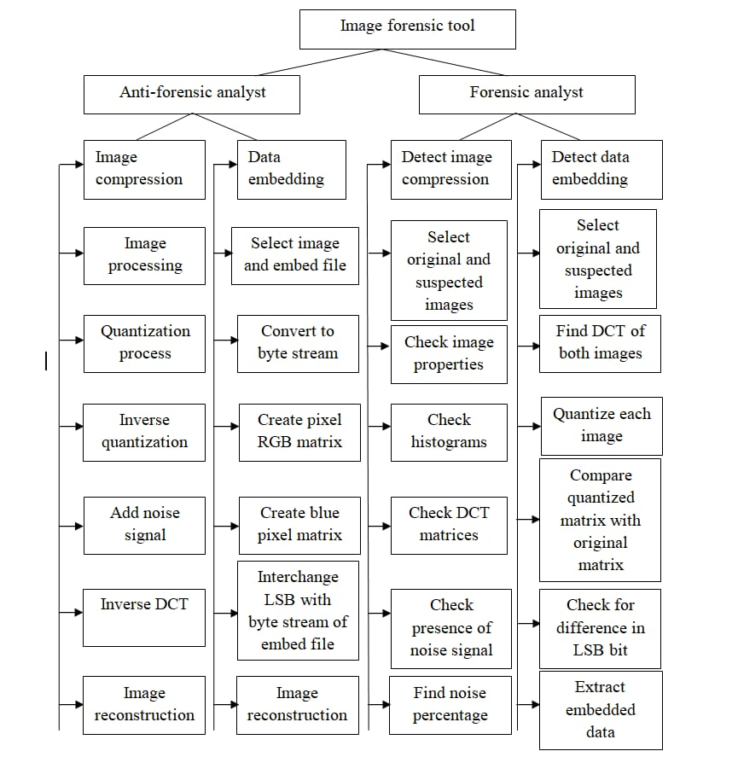
DESCRIPTION OF THE PROJECT

Slide 4
OBJECTIVES OF THE PROJECT
The availability of powerful graphic editing software, makes it easy to create image forgeries. As a result, a number of forensics methods have been developed for detecting digital image forgeries.
In order to improve the existing forensics method, anti-forensics methods have to be developed so that the loopholes in the existing forensics methods can be identified and hence forensics methods can be improved.
By doing so, researchers can be made aware of which forensics techniques are capable of being deceived, thus preventing altered images from being represented as authentic.
A large number of image forensics methods are available which are capable of identifying image tampering. But these techniques are not capable of addressing the anti-forensic method which is able to hide the trace of image tampering.
This anti-forensics method is capable of removing the traces of image compression. Anti-forensics method is capable of removing the traces of image compression.

Slide 5
EXISTING SYSTEM AND PROPOSED SYSTEM

Slide 6
EXISTING SYSTEM
The widespread availability of photo editing software has made it easy to create visually convincing digital image forgeries.
To address this problem, there has been much recent work in the field of digital image forensics.
There has been little work, however, in the field of anti-forensics, which seeks to develop a set of techniques designed to fool current forensic methodologies.
In the existing system we can find whether an image is undergone any malpractices.

Slide 7
PROPOSED SYSTEM
To limit the hazards connected to misuse of digital images, in the past few years, a variety of digital image forensic techniques have been proposed by the forensic community.
Forensic techniques analyze the image content in order to find traces left by specific acquisition, coding or editing operations.
We build on the observation that the anti-forensic dither is a noisy signal which cannot replace the image content lost during quantization.

Slide 8
MODULE DESCRIPTION
IMAGE PREPROCESSING
DCT HISTOGRAM GENERATION
QUANTIZATION MECHANISM
COMPARISON OF MATRICES

Slide 9
ALGORITHM
Contrast enhancement pixel algorithm(DCT)
Discrete wavelet transform algorithm(DWT)

Slide 10
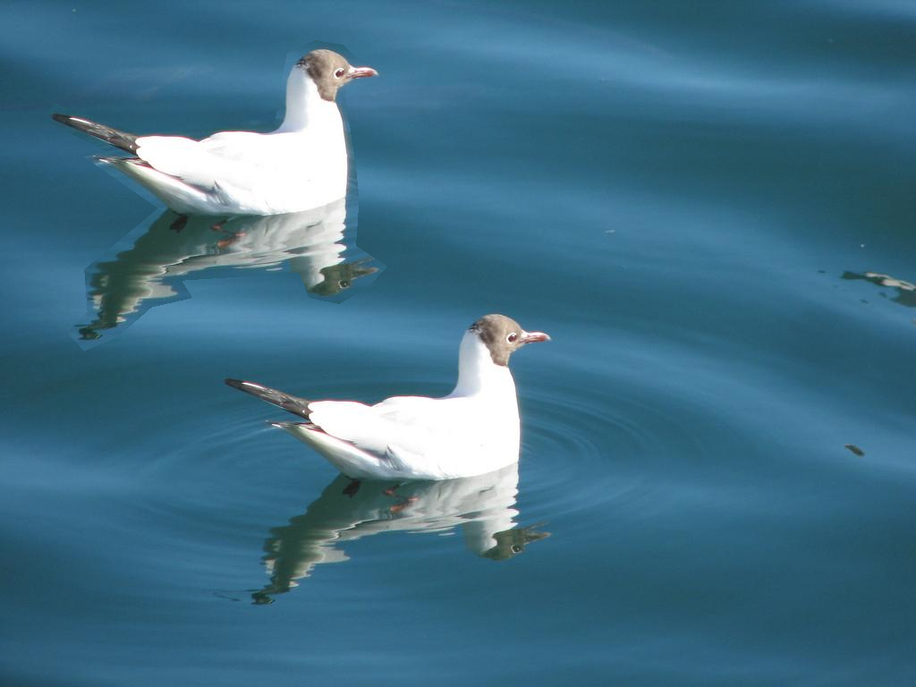
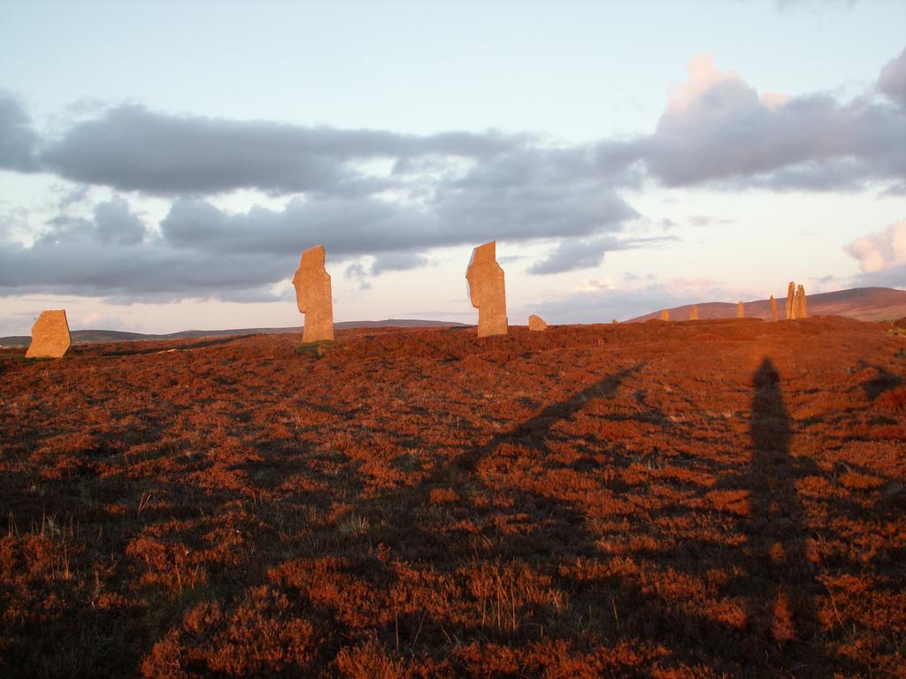
DATASET
The dataset have been collected from kaggle.com.

Slide 11
REFERENCES
[1] https://sci-hub.hkvisa.net/10.1109/TIFS.2014.2300937
[2] https://www.kaggle.com/datasets?search=Contrast+Enhancement+Based+Forensics+in+Digital+Images

Slide 12
THANK YOU

